Slide 1


Slide 2


Slide 3
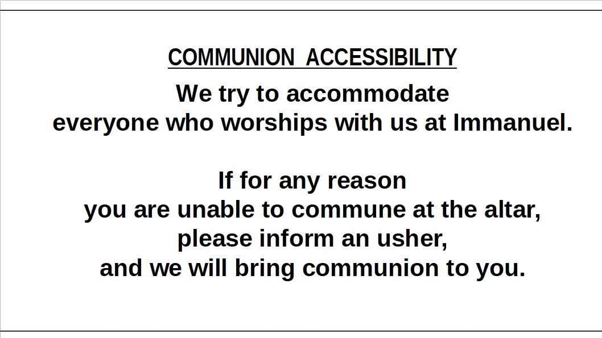

Slide 4
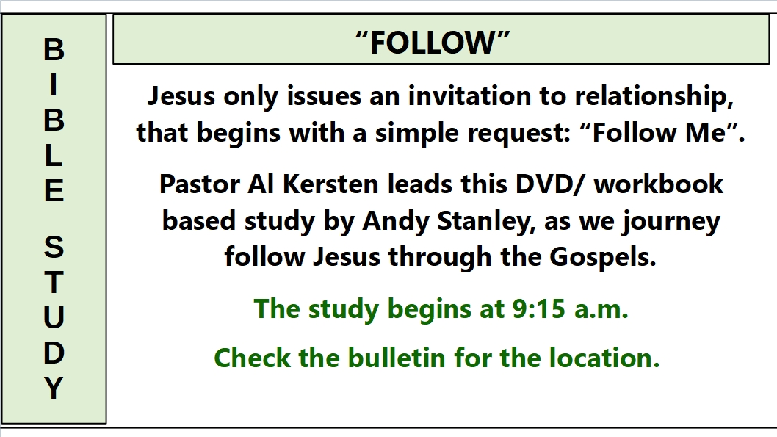

Slide 5
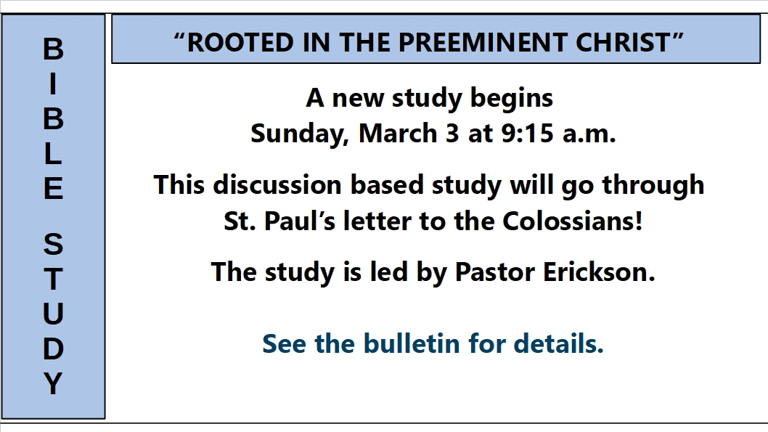

Slide 6
B
I
B
L
E
S
T
U
D
Y
“EARLY BIRD BIBLE STUDY”
This study meets Monday mornings
at 7:00 A.M. in the lighthouse room
of the Thunder Bay River Restaurant.
Pastor Erickson leads
this current study
is in the book of 1 Kings.

Slide 7
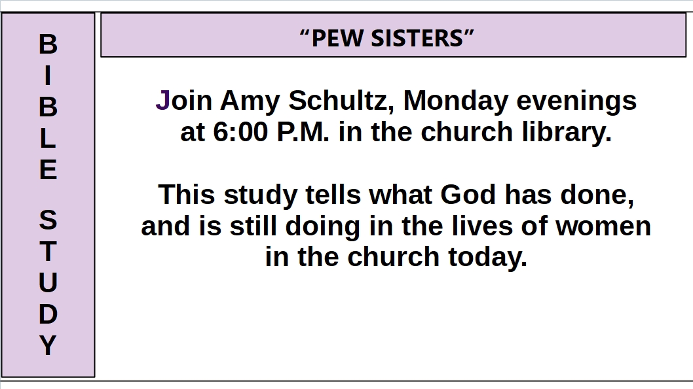

Slide 8
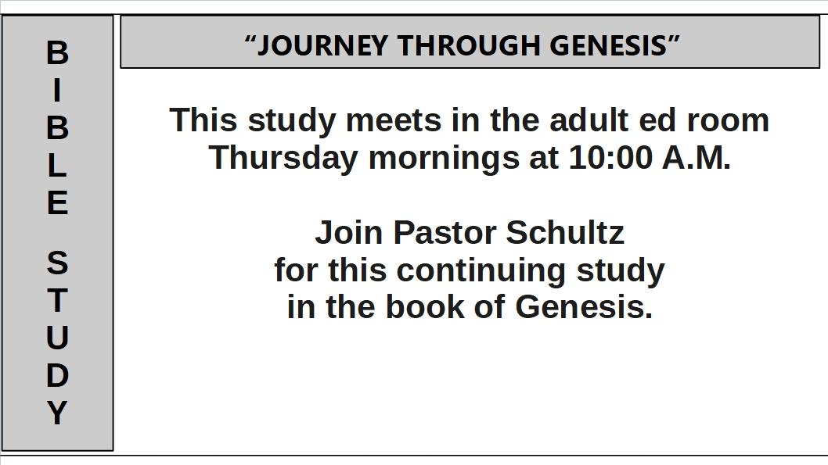

Slide 9


Slide 10


Slide 11


Slide 12


Slide 13


Slide 14


Slide 15


